Slide 1


Slide 2
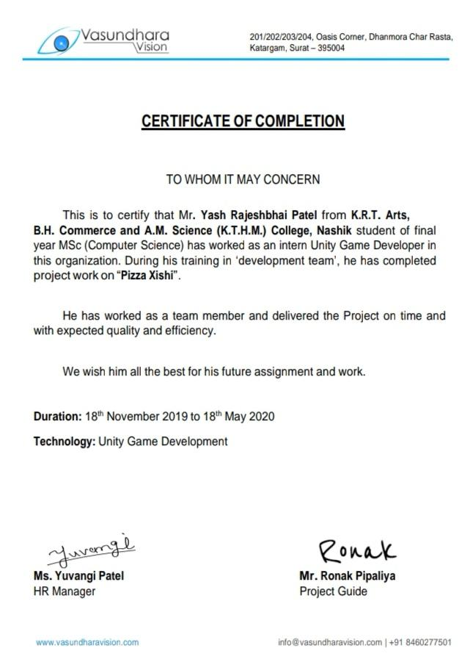

Slide 3
Description:-
Look at the real-time machine where pizza appears, let the xishi fall steadily into the middle of the pizza, let the pile of pizza piled up higher.
GAMEPLAY: -
Let's jump on the pizza flying over from left to right. Continuous jump in the center of the pizza will be a perfect jump, multiple perfect jumps to improve scores, aim for higher targets and jump.
GAME FEATURES: -
◆fingertip cute game: -
Just move your fingers and get started easily. A wonderful mood and the rhythm of the xishi's beating challenge the perfect jump and higher scores. ◆ Addictive magic gameplay: - Super cute animated sound, fun. Many perfect jumps, you can see the super-difficult performance of the pizza xishi. ◆ Skin collection Pizza unlock: - Use the collected gold coins to buy pizza in the pizza shop, achieve the achievement to unlock the new pizza background, and experience the fun of collecting.

Slide 4
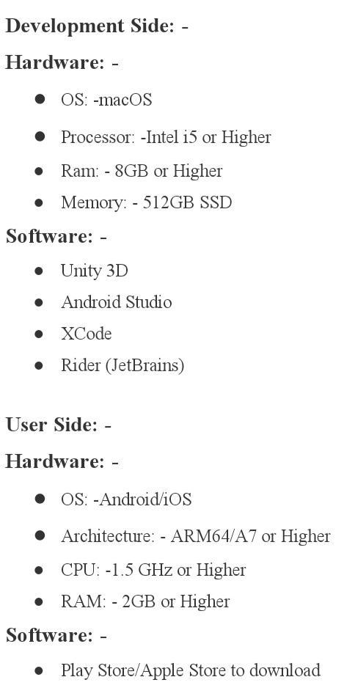

Slide 5
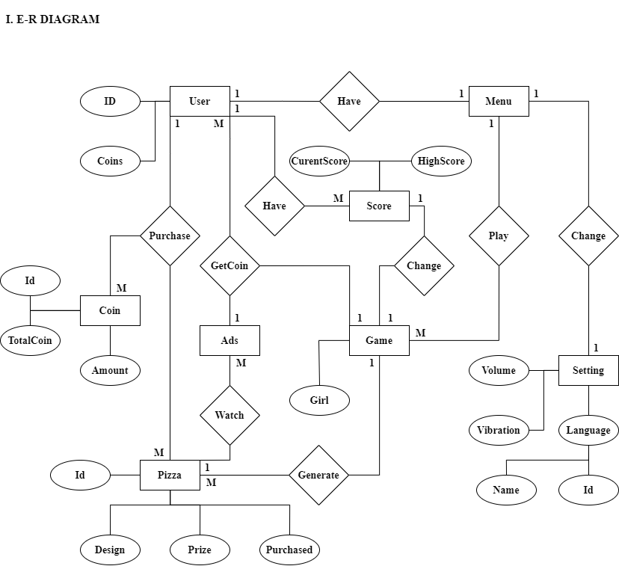

Slide 6
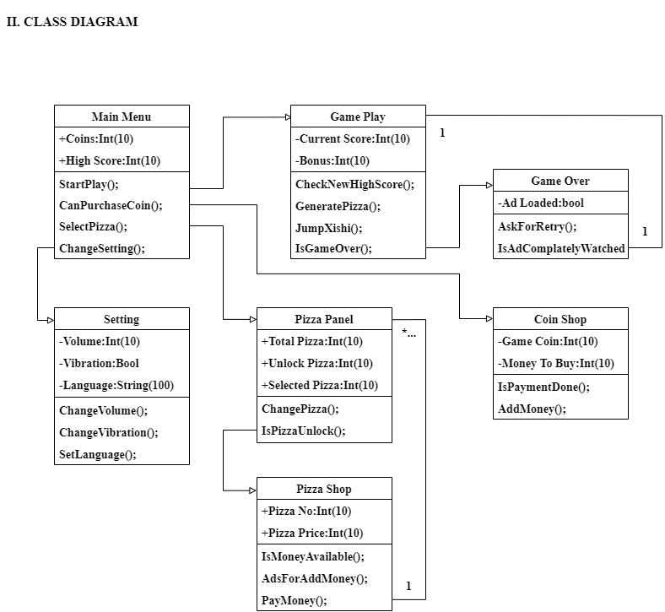

Slide 7
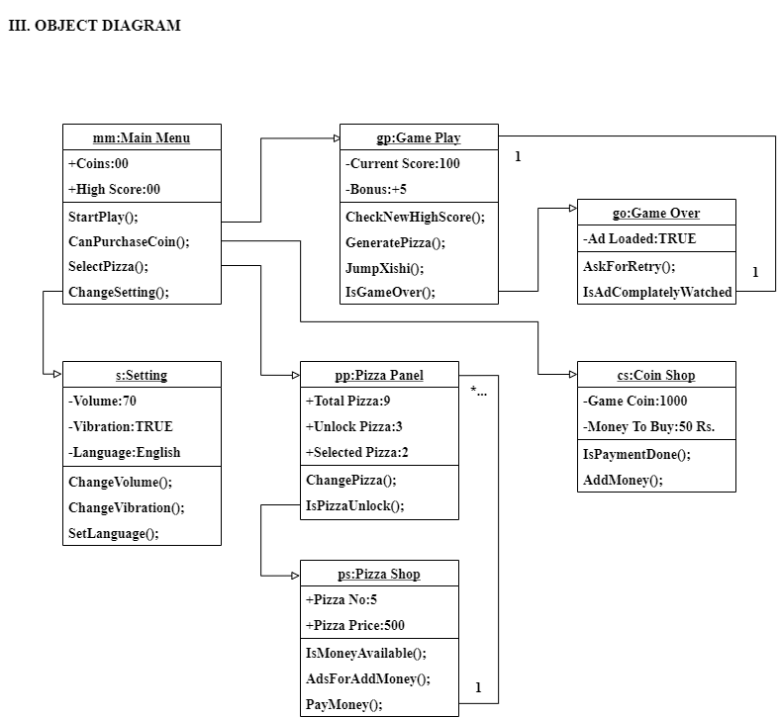

Slide 8
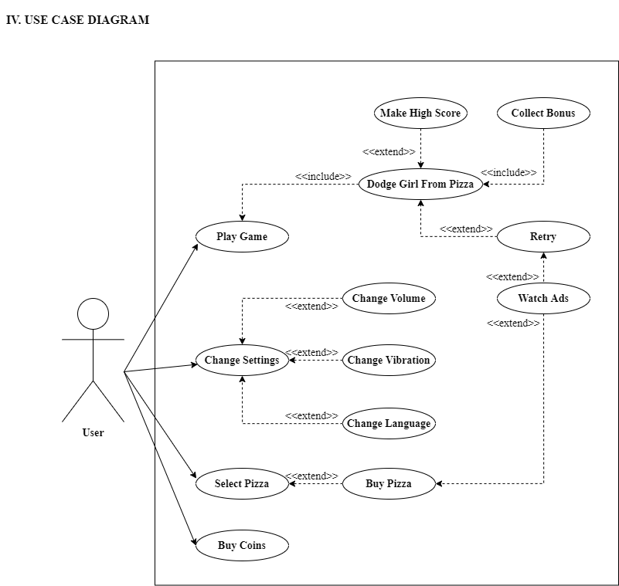

Slide 9
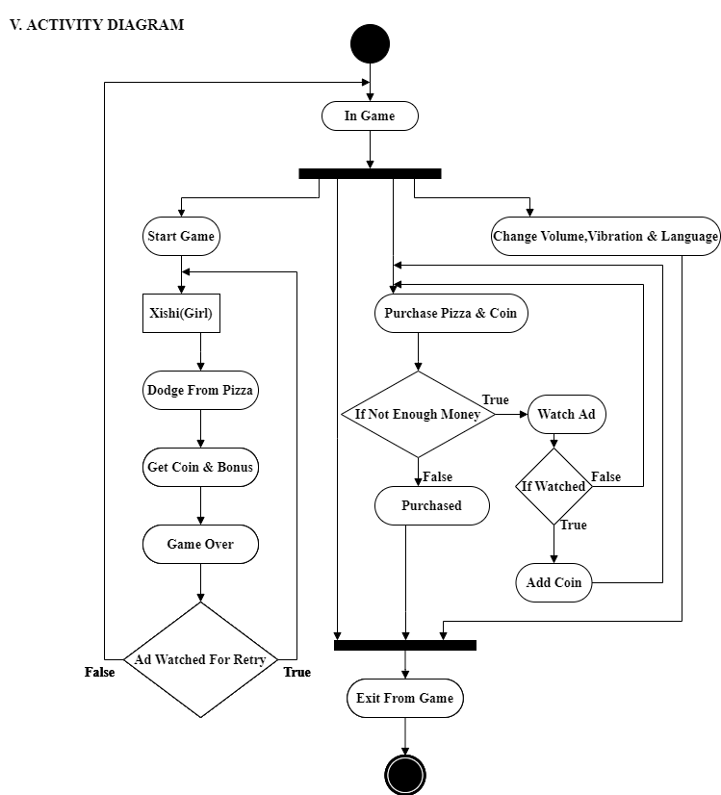

Slide 10
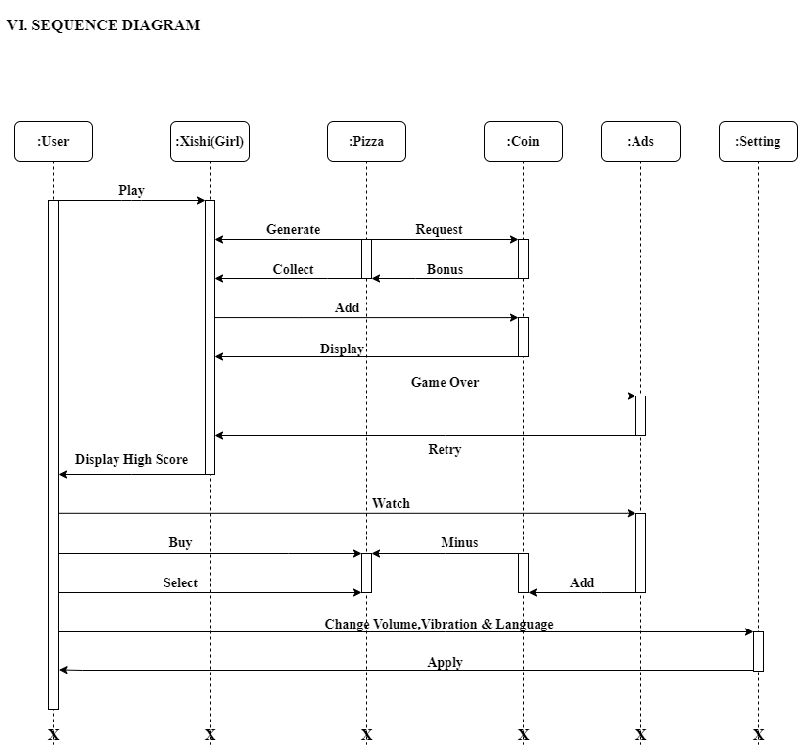

Slide 11
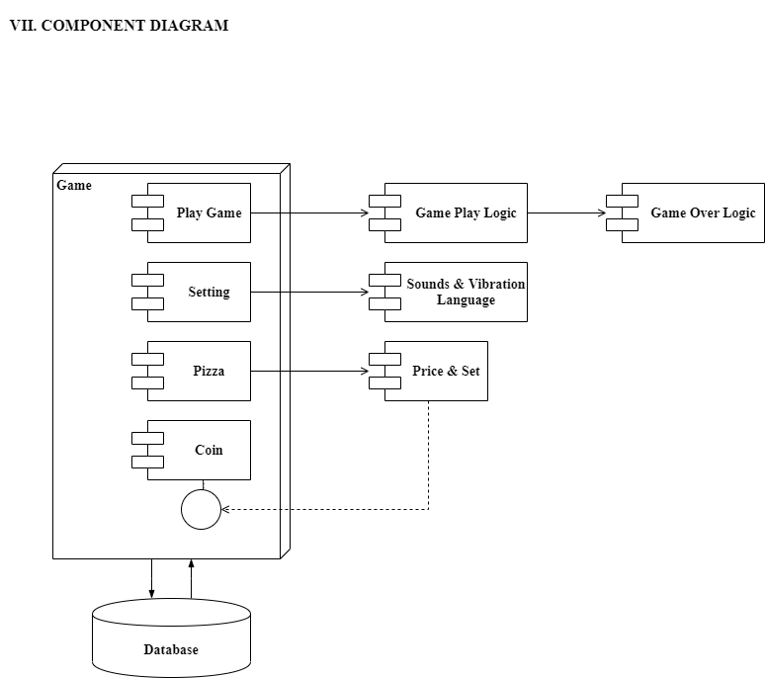

Slide 12
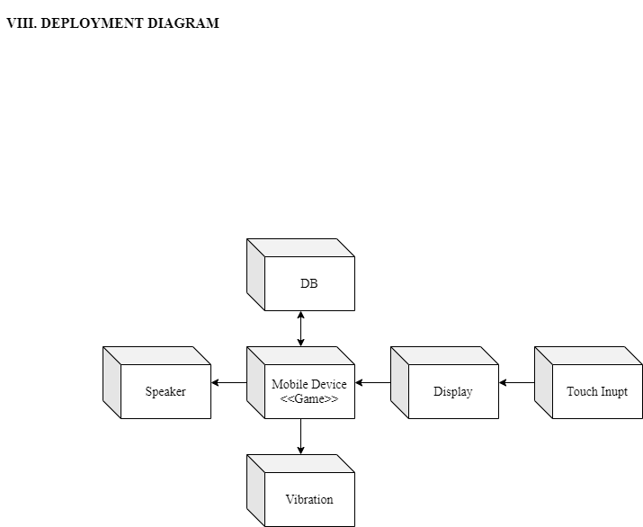

Slide 13
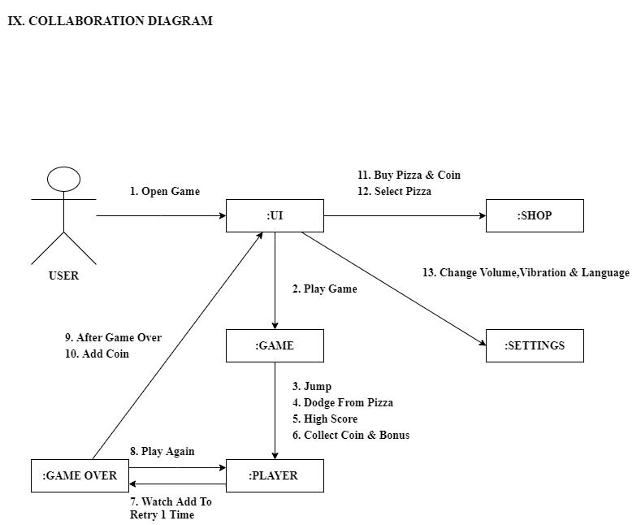

Slide 14
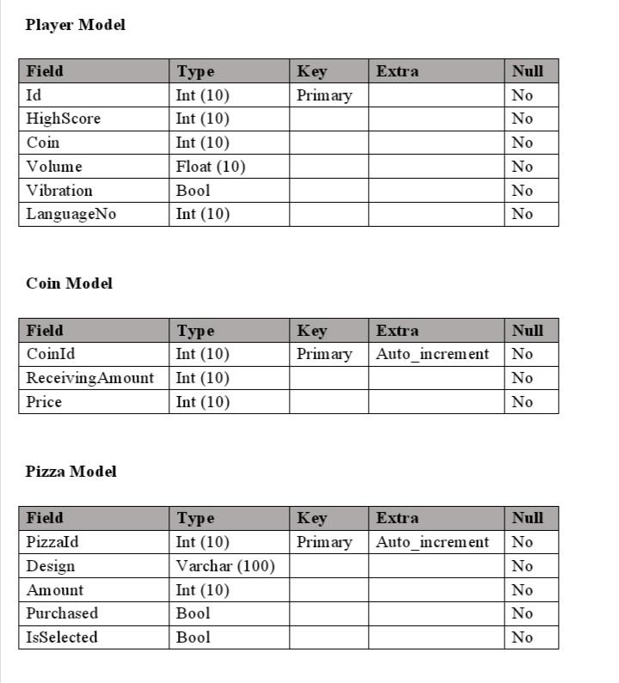

Slide 15
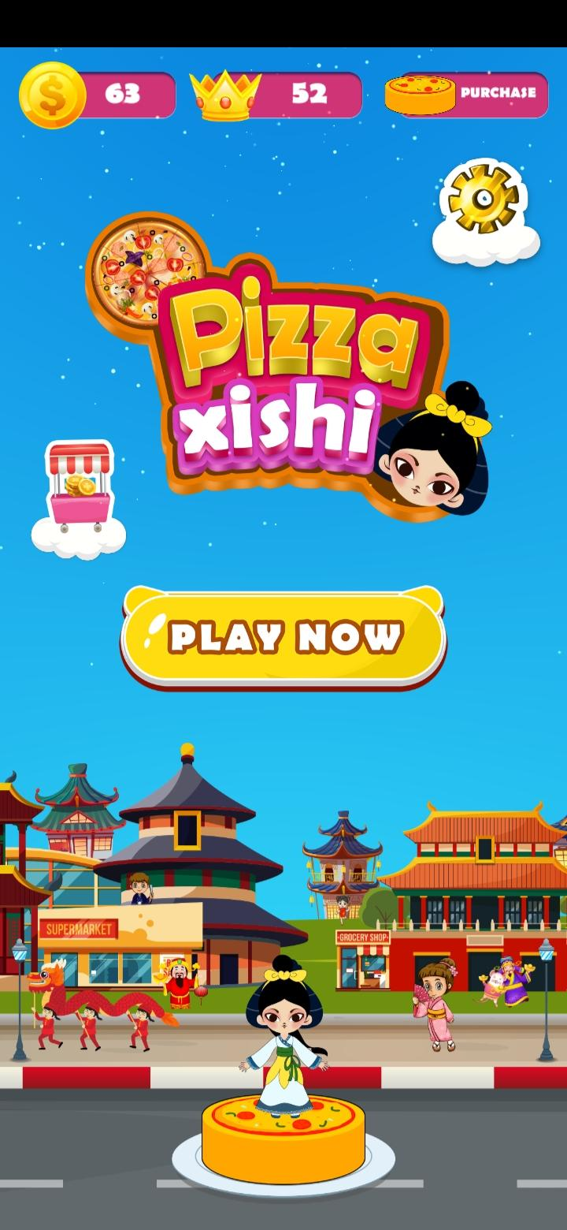
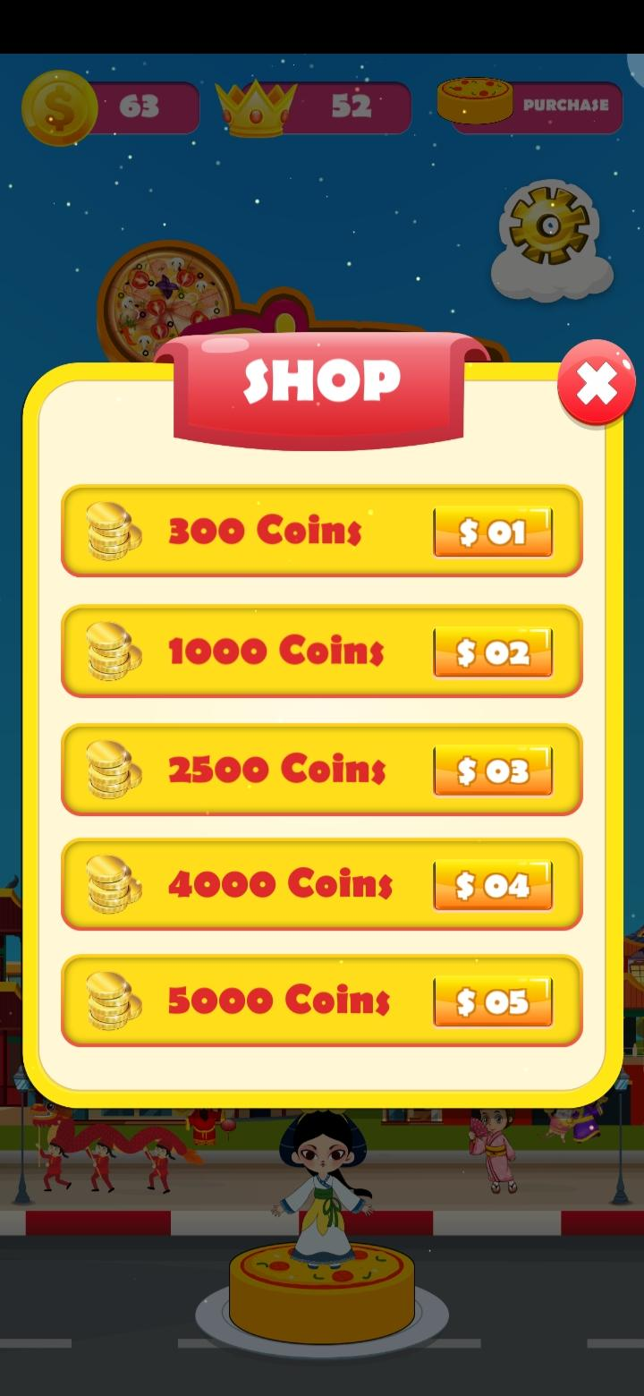
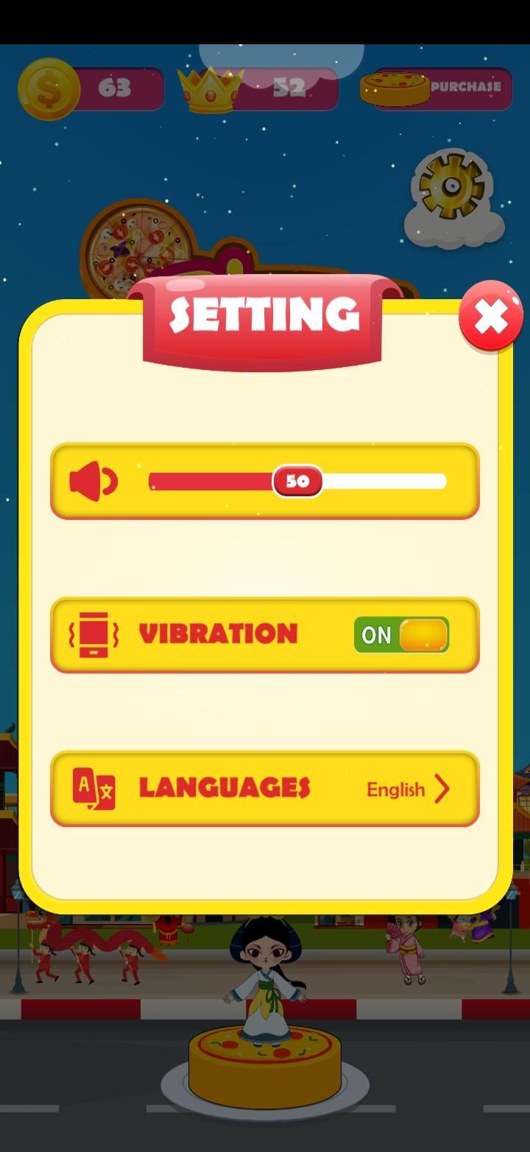

Slide 16
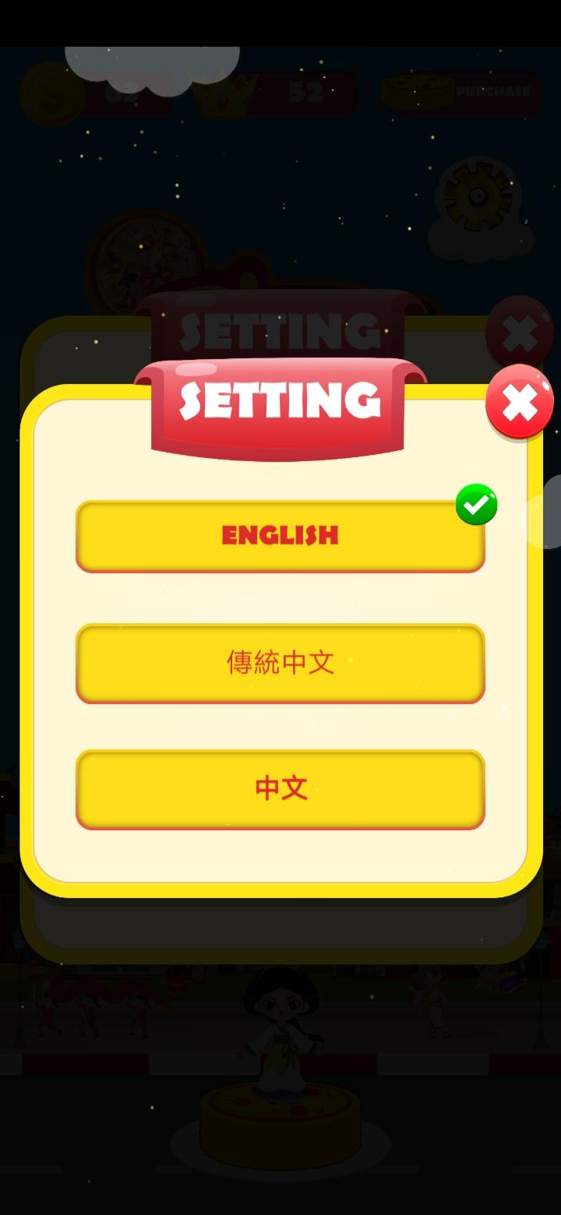
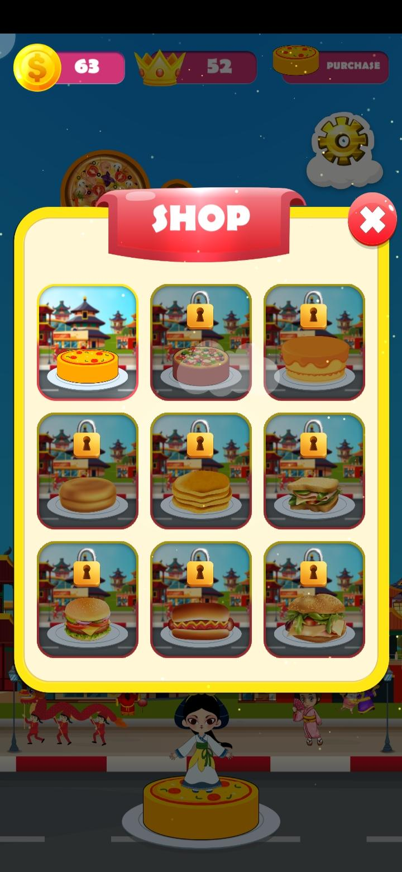
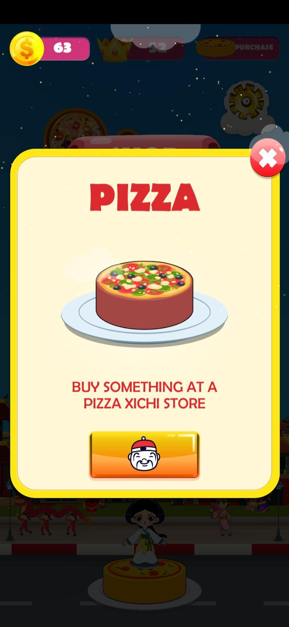

Slide 17
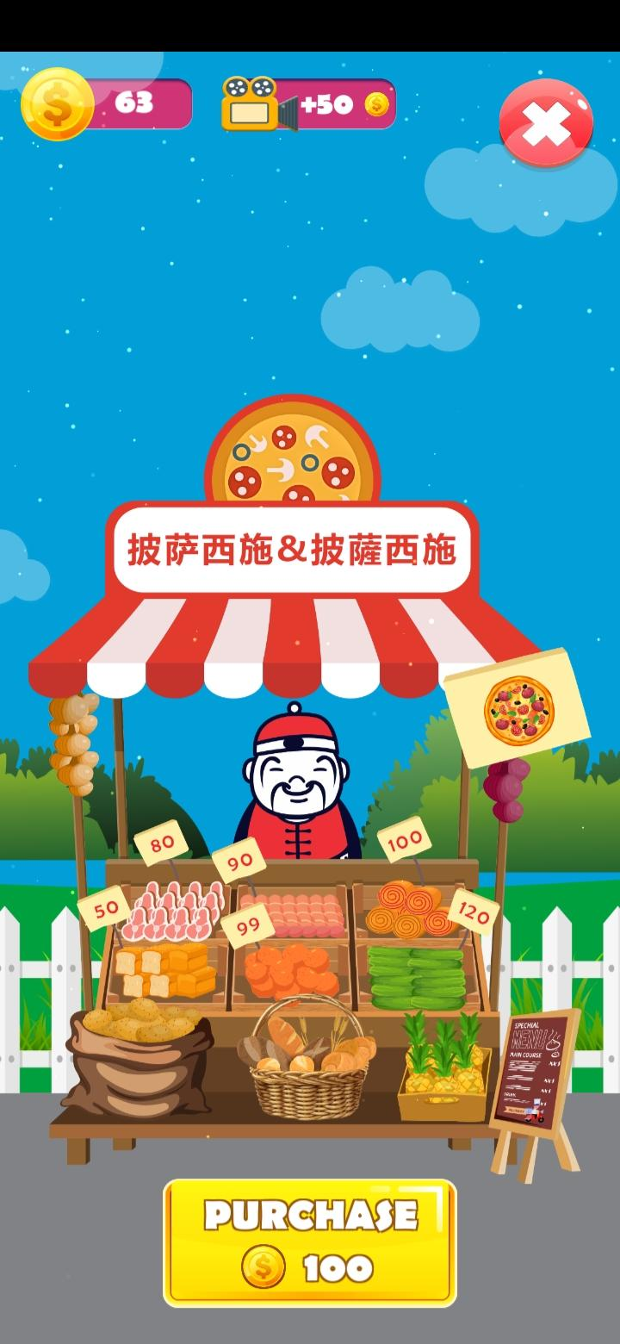

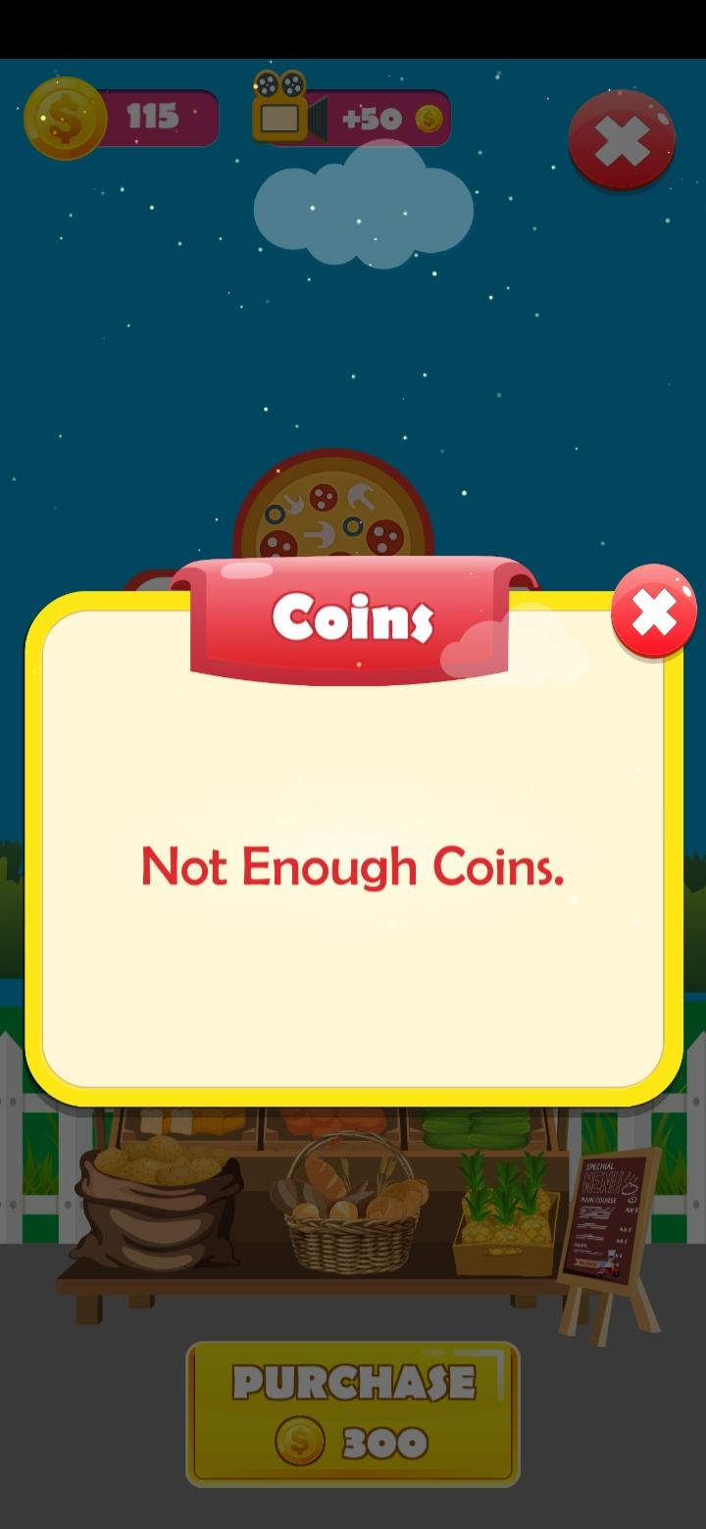

Slide 18
